Slide 1
Fashion Shazam
Final Project
Team 16
12/07/2026

Slide 2




Motivation & Business Use Case
“That outfit is tough. I wish I knew where its from and how much it costs. ”

Slide 3

Data Sources
Fashion MNIST
Train Category Classification
60,000 train / 10,000 test; resized -> 224x224 RBG
H&M Product Dataset
Train Price Estimation
High-resolution images + metadata price labels

Slide 4

Model Architecture
2-Stage Deep Learning Pipeline
Classification
ResNet-18 (ImageNet-pretrained) to detect clothing category
10-class softmax output
Regression
Replace softmax with a price-prediction layer
Freeze early layers
Train only regression head using RMSE loss

Slide 5
Training & Implementation Details
Batch Size 128
AdamW Optimizer
Cosine LR Scheduler
Light Augmentation
Model Checkpoints
GPU Efficiency
Better Generalization
Stable Convergence
Reduce Overfitting
Best-model Preservation
Notes:
“Once we finalized the architecture, we focused on training efficiency and model stability. We used PyTorch with GPU acceleration and a batch size of 128 to process images quickly.
To prevent overfitting while keeping training simple, we added light data augmentation — things like random crops and horizontal flips — so the model sees more real-world variation in how clothing is positioned.
We optimized using AdamW, which helps with generalization by decoupling weight-decay from adaptive learning.
And to make sure the model converges smoothly instead of plateauing early, we used a cosine annealing learning-rate schedule, which gradually lowers the learning rate over time.
Finally, we tracked checkpoints throughout training and always restored the best-performing weights, ensuring we carry the strongest classifier forward into the pricing stage.”

Slide 6
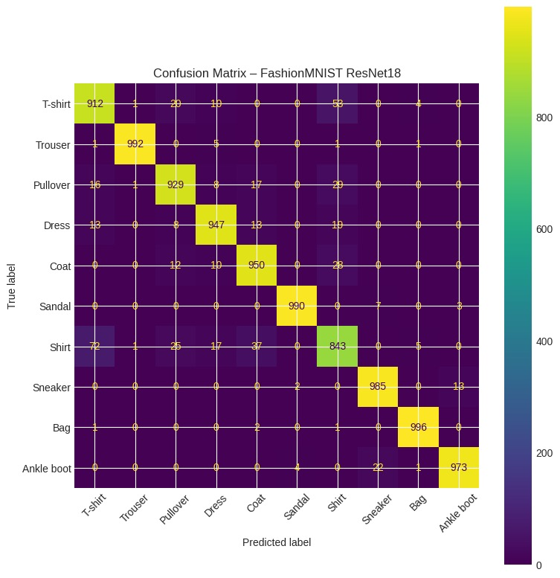
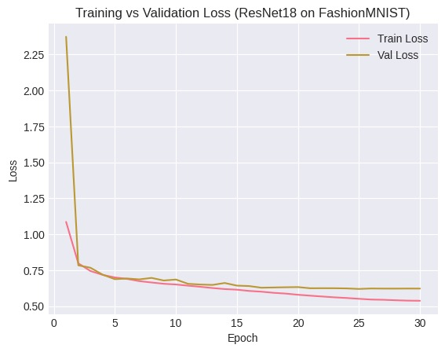
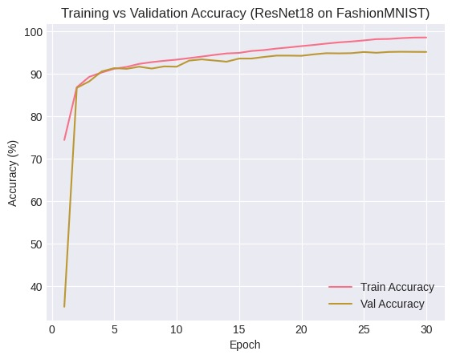
Classification
95.43% accuracy on Fashion MNIST Test Set
Learns quickly & generalizes well
Notes:
“The model learned fashion categories extremely quickly. In just three epochs, it already surpassed 90% accuracy, showing that the ImageNet-pretrained layers were effective at identifying clothing features.
By convergence, we achieved 95.43% test accuracy, which means the model is highly reliable for visual understanding and categorization.
The confusion matrix on the right shows strong diagonal dominance — meaning almost every item is classified correctly — with very few mix-ups between visually similar categories like pullover vs coat or shirt vs t-shirt.
And importantly, the training and validation loss curves track closely, which confirms that the model generalizes rather than memorizes.
With accuracy this high, we were confident the classifier could serve as a strong feature-extractor for our price estimation stage.”

Slide 7
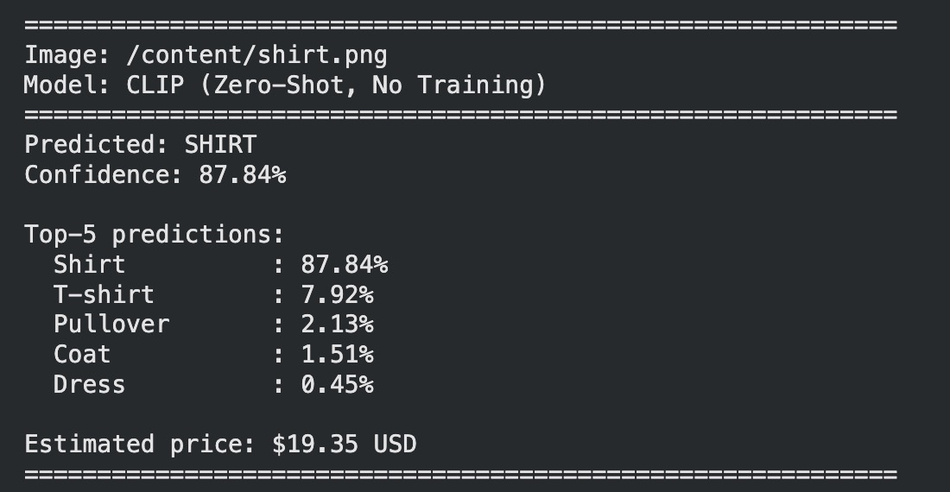
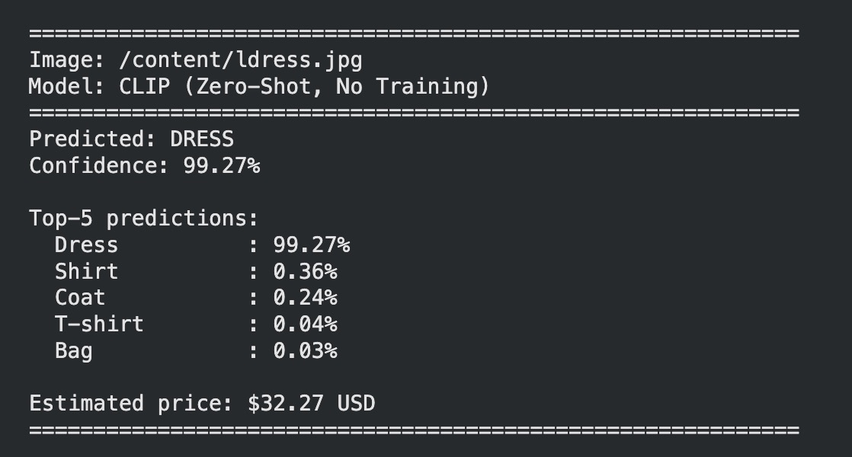
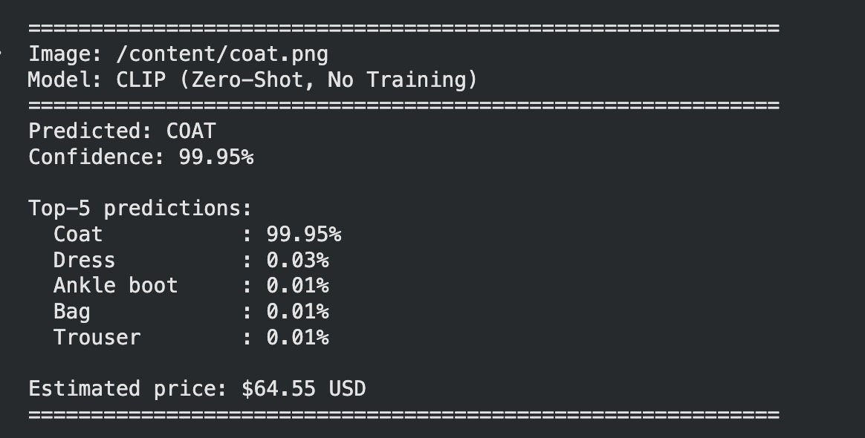
Price Estimation

Slide 8

Deployment Vision
Website & App!!!
Upload -> Classify -> Estimate -> Link Similar Recommendations!
Automated Pricing
Marketplace Conversions
Trend Analytics
Inventory Value Optimization

Slide 9

Challenges & Next Steps
Limited Visual Variation
10 Categories
No Brand/Material Cues
Colab Compute Ceiling

Slide 10
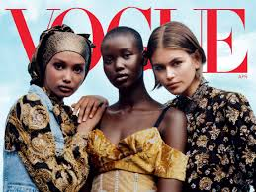
Conclusion & Takeaway
Deep learning can identify fashion items accurately
Pricing signals are learnable from product data
Platform has strong commercialization potential
Recommend similar products/styles
Incorporated into fashion brands & aesthetic media
Bright future

